Slide 1
Cabin Service Dispatch
Multi-task
Strategy
Knowledge
Clarity
Quality
Timing
By:
Carolina Smith-Fitisemanu
Comm1010
July 13, 2011
Delays
Teamwork

Slide 2
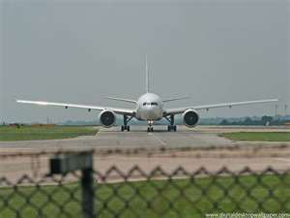
Knowledge
When do the planes get on the ground?
How much time do we have?
How long should each plane take?
City codes
Relaying messages
Safety

Slide 3
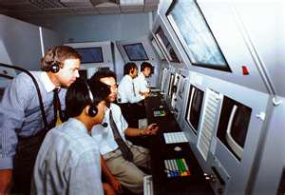
Clarity
Speaking over the radio
Understand what is being
cleared
Mistakes can be costly
Copy and copy back

Slide 4
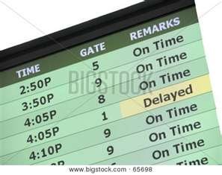
Delays
Importance of not
getting one
Fighting to avoid a delay
Responsible for Delay costs and personal impact
Timing is everything
Times of each turn depending on plane size

Slide 5
Bibliography
"Dispatch(logistics)." Wikipedia.org. Wikipedia, 29 Nov. 2010. Web. 13 July 2011. <http://www.wikipedia.org>.
Interview: Jason Shipman- Delta Dispatcher
Jason.shipman@delta.com
"Police, Fire, and Ambulance Dispatchers." Www.bls.gov. Bureau of Labor Statistics, 17 Dec. 2009. Web. 13 July 2011. <http://www.bls.gov/oco/ocos343.htm>.

